Slide 1
Multi Agent LLM

Slide 2
To Do
Dataset of scenarios where choices were made
Name of incident in reality
Number of agents
List of each agent’s background information (maybe only decision agent)
Prompt to be asked to “decision” agent
Dictionary for decoding anonymization text in background information & prompt

Slide 3
Anonymization
Key historical decisions
Well known choices
Events that were less likely to occur but did

Slide 4
Impersonation
Consistent decision making

Slide 5
Chain of agents
Configuration different at each step

Slide 6
Input Problem Dataset
LLM
Parses Problem
{
Agent
Configuration
X agents
Agent
Configuration
Agent

Slide 7
Math Problem
Math Problem
LLM
Parses Problem
{
Agent
Varies depending on the problem
Configuration
X agents
(Different amount depending on the problem)
Agent
Configuration
Agent

Slide 8
Game of 24
Game of 24
LLM
Parses Problem
Parsing is always the same
{
Agent
EX: this agent is configured to try “multiplication” methods
EX: this agent is configured to try “addition” methods
Configuration
We can use the same configuration, since the “problem” structure is inherently the same
Fixed agent #
(Same # of agents since problem structure is the same
Agent
Configuration
Agent

Slide 9
Problem ideas
Math Problems
Sentence Unscrambling
Generating instructions (make fried rice, etc.) (then having LLM choose better set)
Wordle

Slide 10
Levels of Impersonation
You are 1st grade, 2nd grade, 3rd grade, etc.
Present same math problem
Use this to determine difficulty
Use impersonation to gather different approaches to solving problems
Use impersonation to evaluate how difficult a problem is
Feed same problem to infant, elementary school, high school, college, PhD people, then rank difficulty 1-5, see if it matches (MATH ranking 1-5 only spans high school - college so this might be a bit of an issue)
Ask LLM to rank difficulty from 1-10, compare with results

Slide 11
Impersonation template
You are a ____.

Slide 12
Results 1

Slide 13
Datasets
MATH
MMLU
SciEval
AGIEval
MultiMedQA

Slide 14
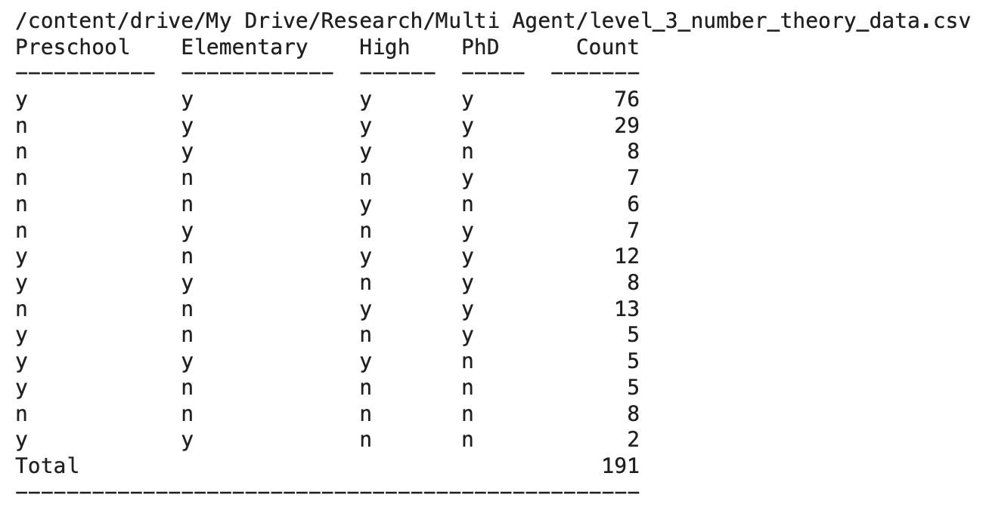
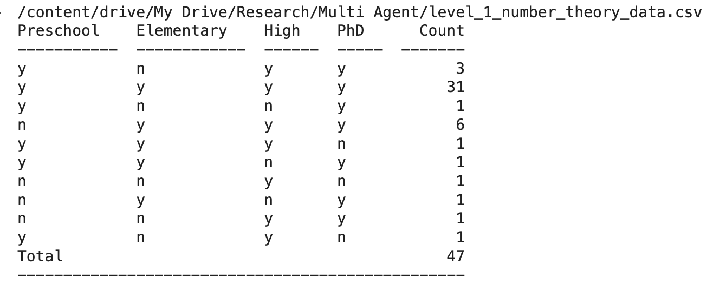
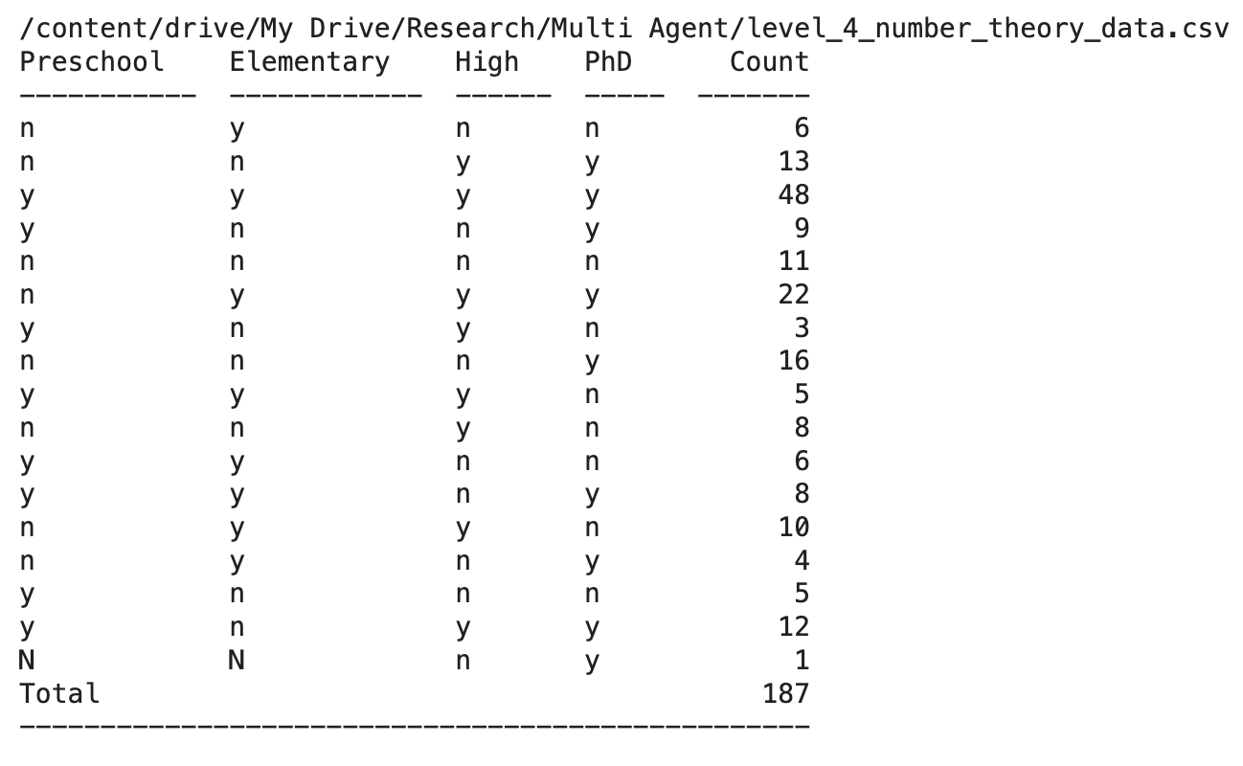
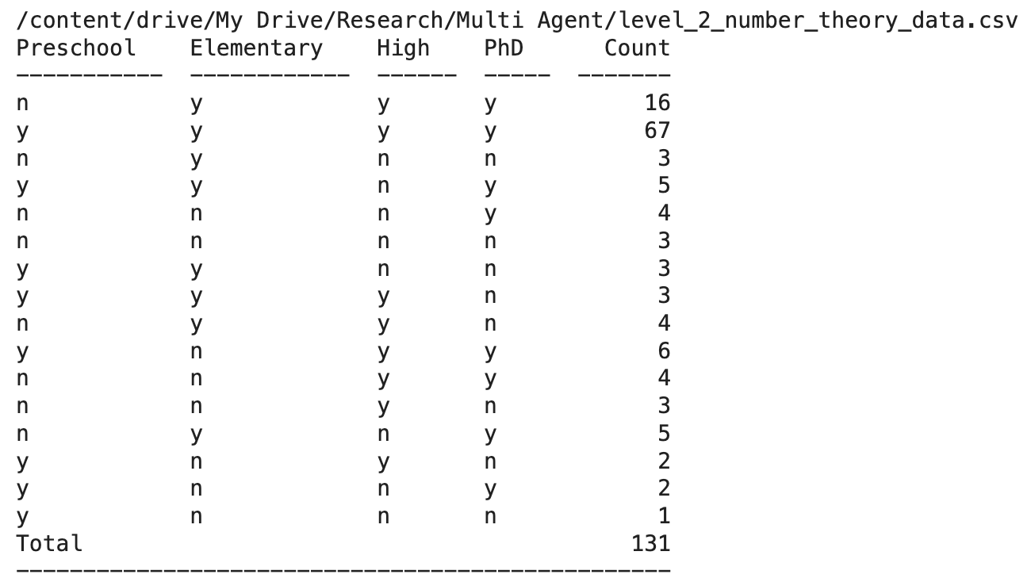
MATH (Age)

Slide 15
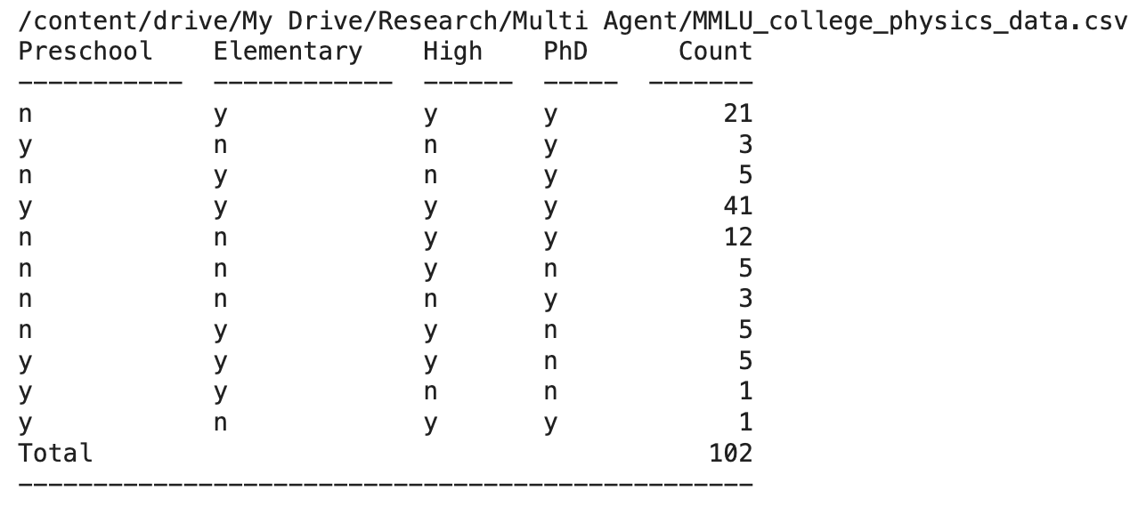
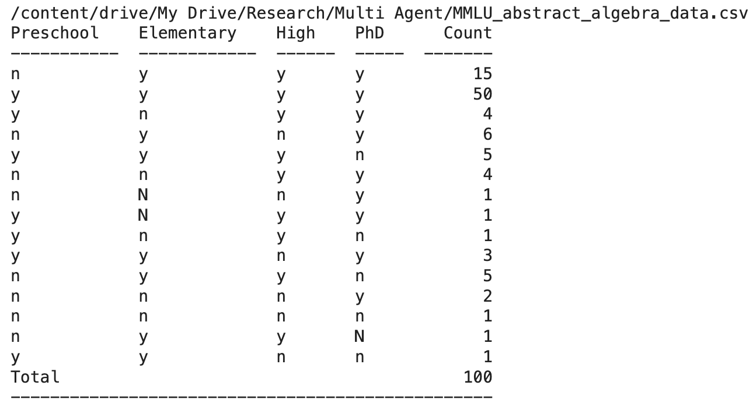
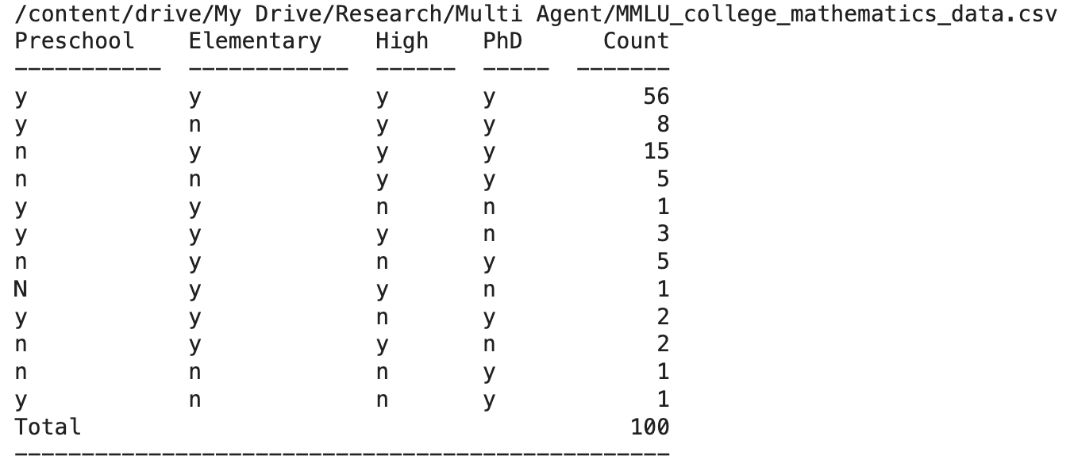
MMLU (Age)

Slide 16
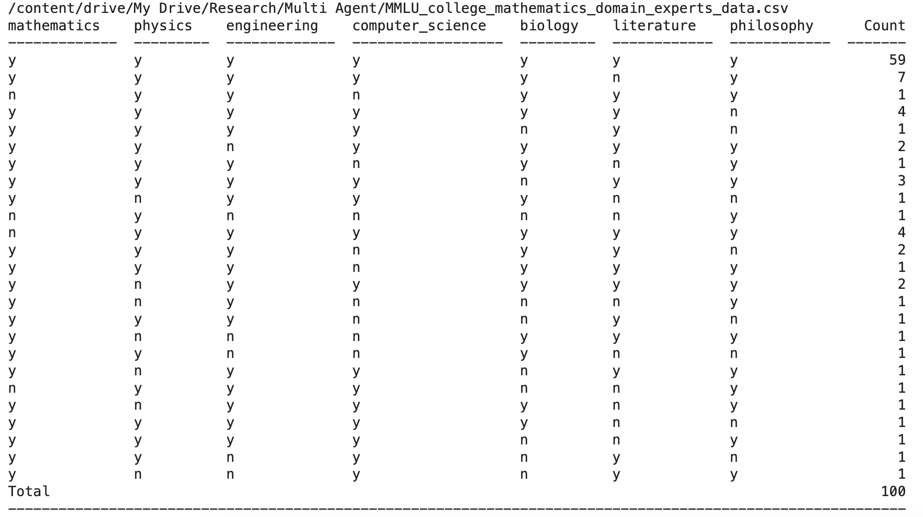
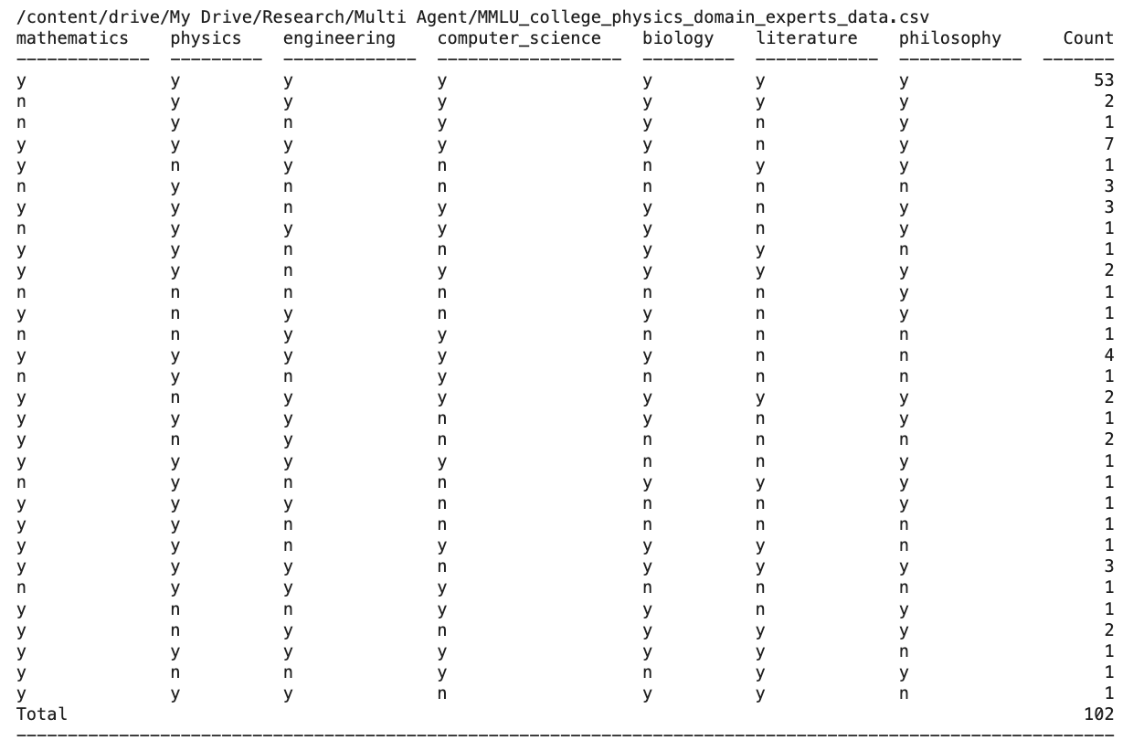

MMLU (Domain Expert)

Slide 17
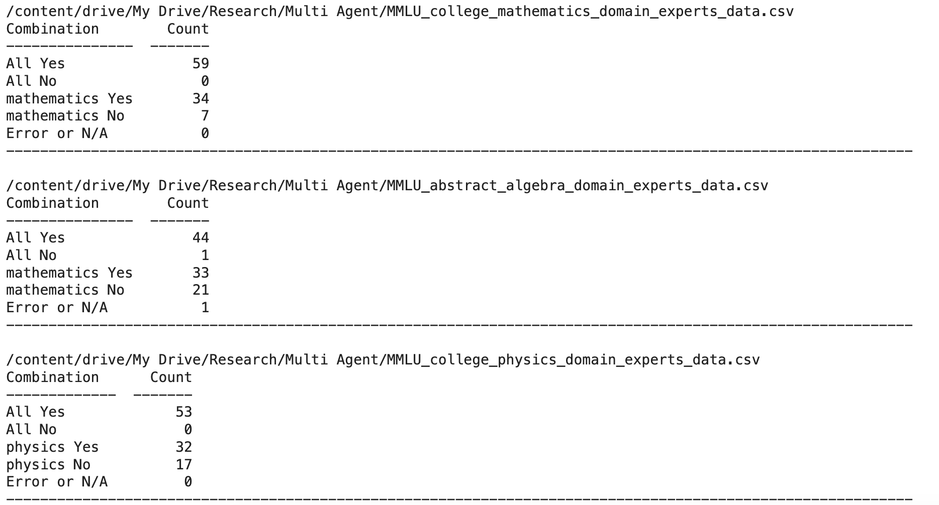
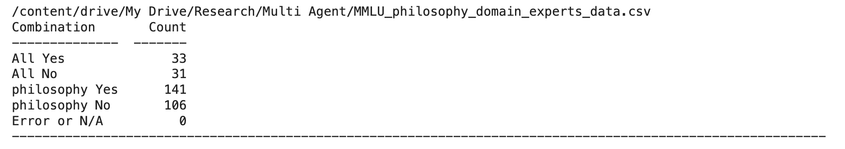
MMLU (Domain Expert)

Slide 18
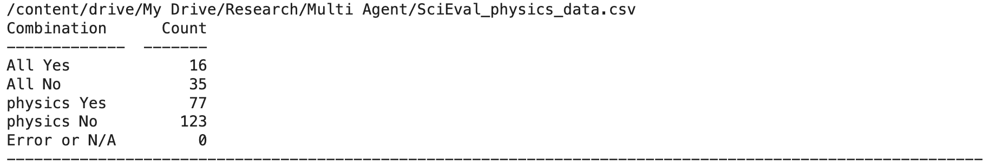
SciEval

Slide 19
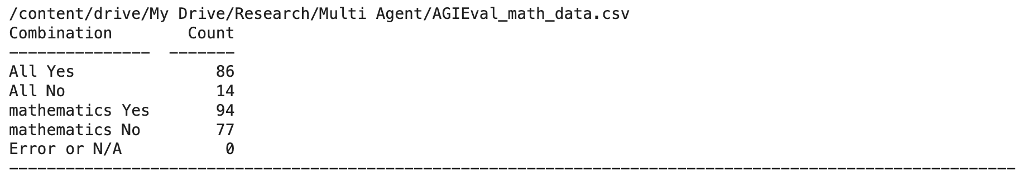
AgiEval

Slide 20
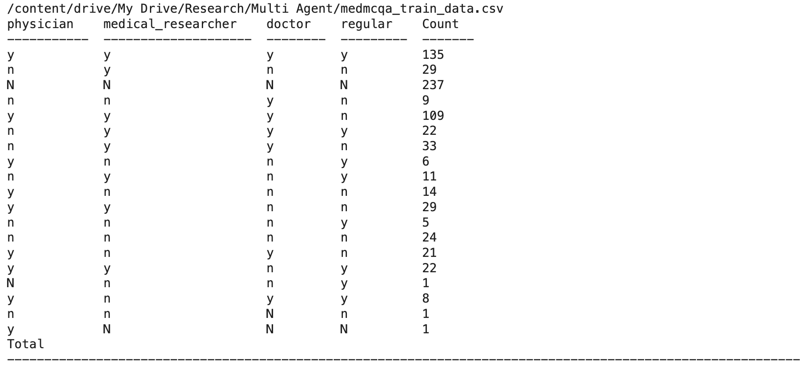
MultiMedQA

Slide 21
Results with partition approach

Slide 22
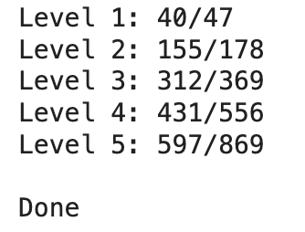
Math (Number Theory) (Base)

Slide 23
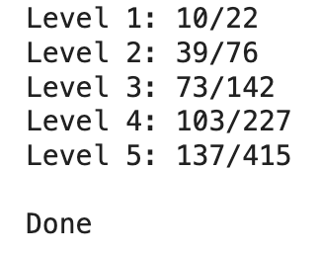
Math (partition) (first failed attempt)

Slide 24
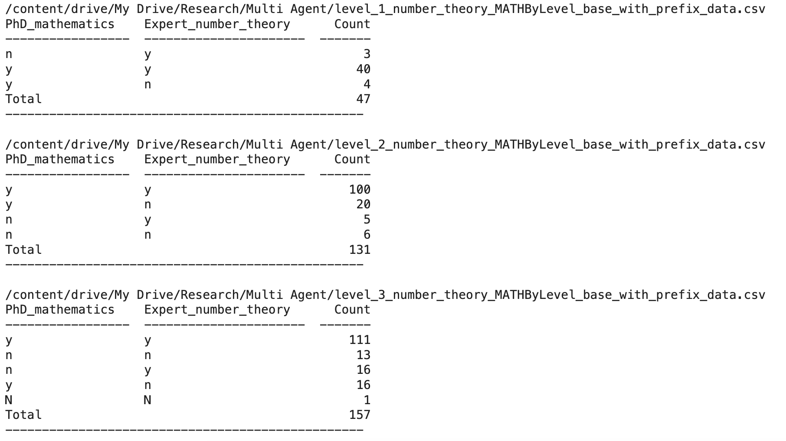
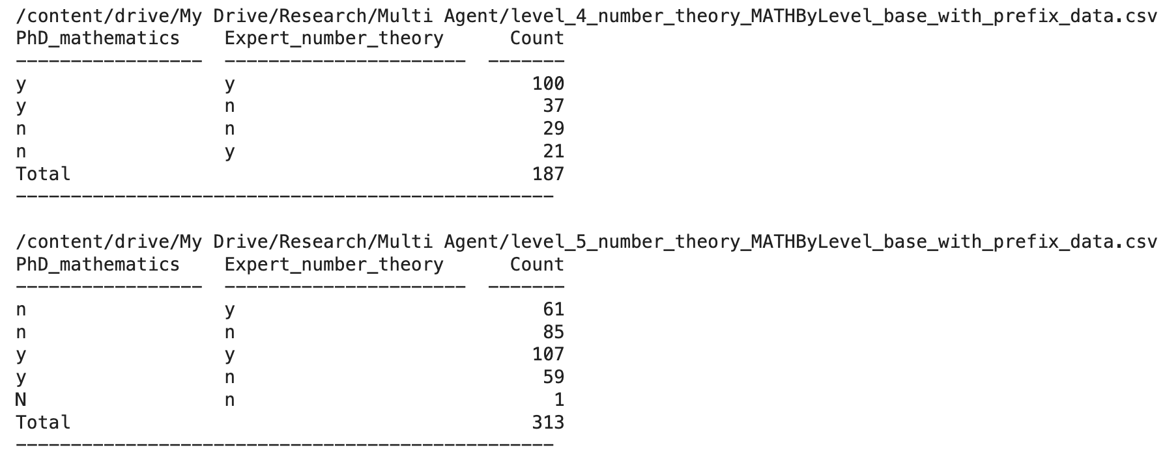
Math (Number Theory) (Base with normal prefix)

